Slide 1
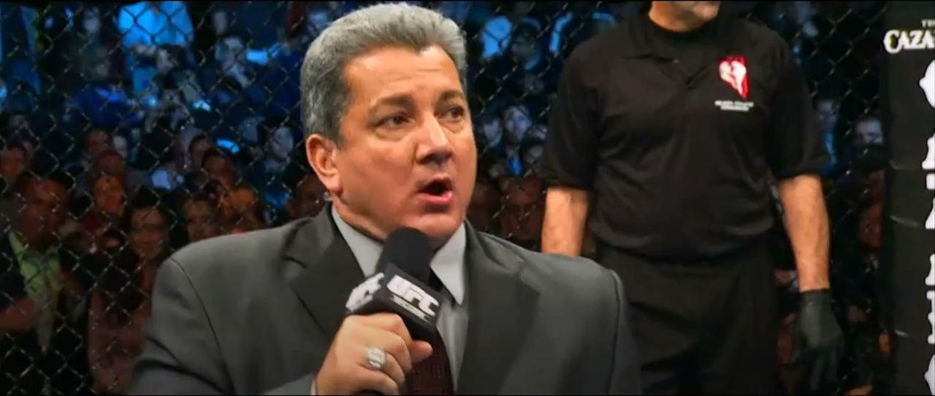
Notes:
Cesar Greeting - 0:15 seconds (“Its Time!”... … “In the Data Science World we all know Dimas is the reigning champ but what about hypothetically in the Octagon? ”)
Priti/Cesar Intro - (breaks down MMA lingo, introduces audience to the world of MMA & stuns with viz) - 3:30 minutes
Cesar hands-off to Mattie - 0:15 seconds
Mattie DB - 3:30 minutes
Cesar hands-off to Andrew - 0:15 seconds
Andrew - ML - 3:30 minutes
Cesar hands-off to self - 0:15 seconds
Cesar/Priti - Results including Interactive Visualization - 2:00 minutes
Closing Slides - Fun Facts, Credits and Sources - 1:30 minutes

Slide 2

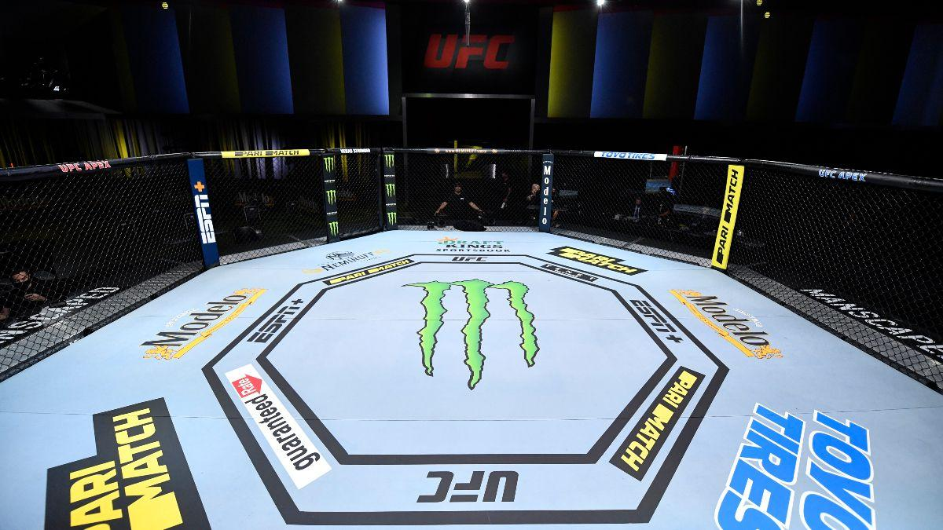
Ladies and Gentlemen
IT’S TIMEEEEE!!!
Notes:
Ladies and Gentlemen.. IT’S TIMEEEEEE!!
We all love to see a good match. Whether it’s basketball, tennis, gymnastics, or even chess.
As fans of any sport, you may find yourself trying to predict the outcome of an upcoming match. Like many others, the nature of fighting can be very unpredictable. The advantage or the outcome of a fight can change in a split second.. But then again, that is what makes it so interesting!

Slide 3
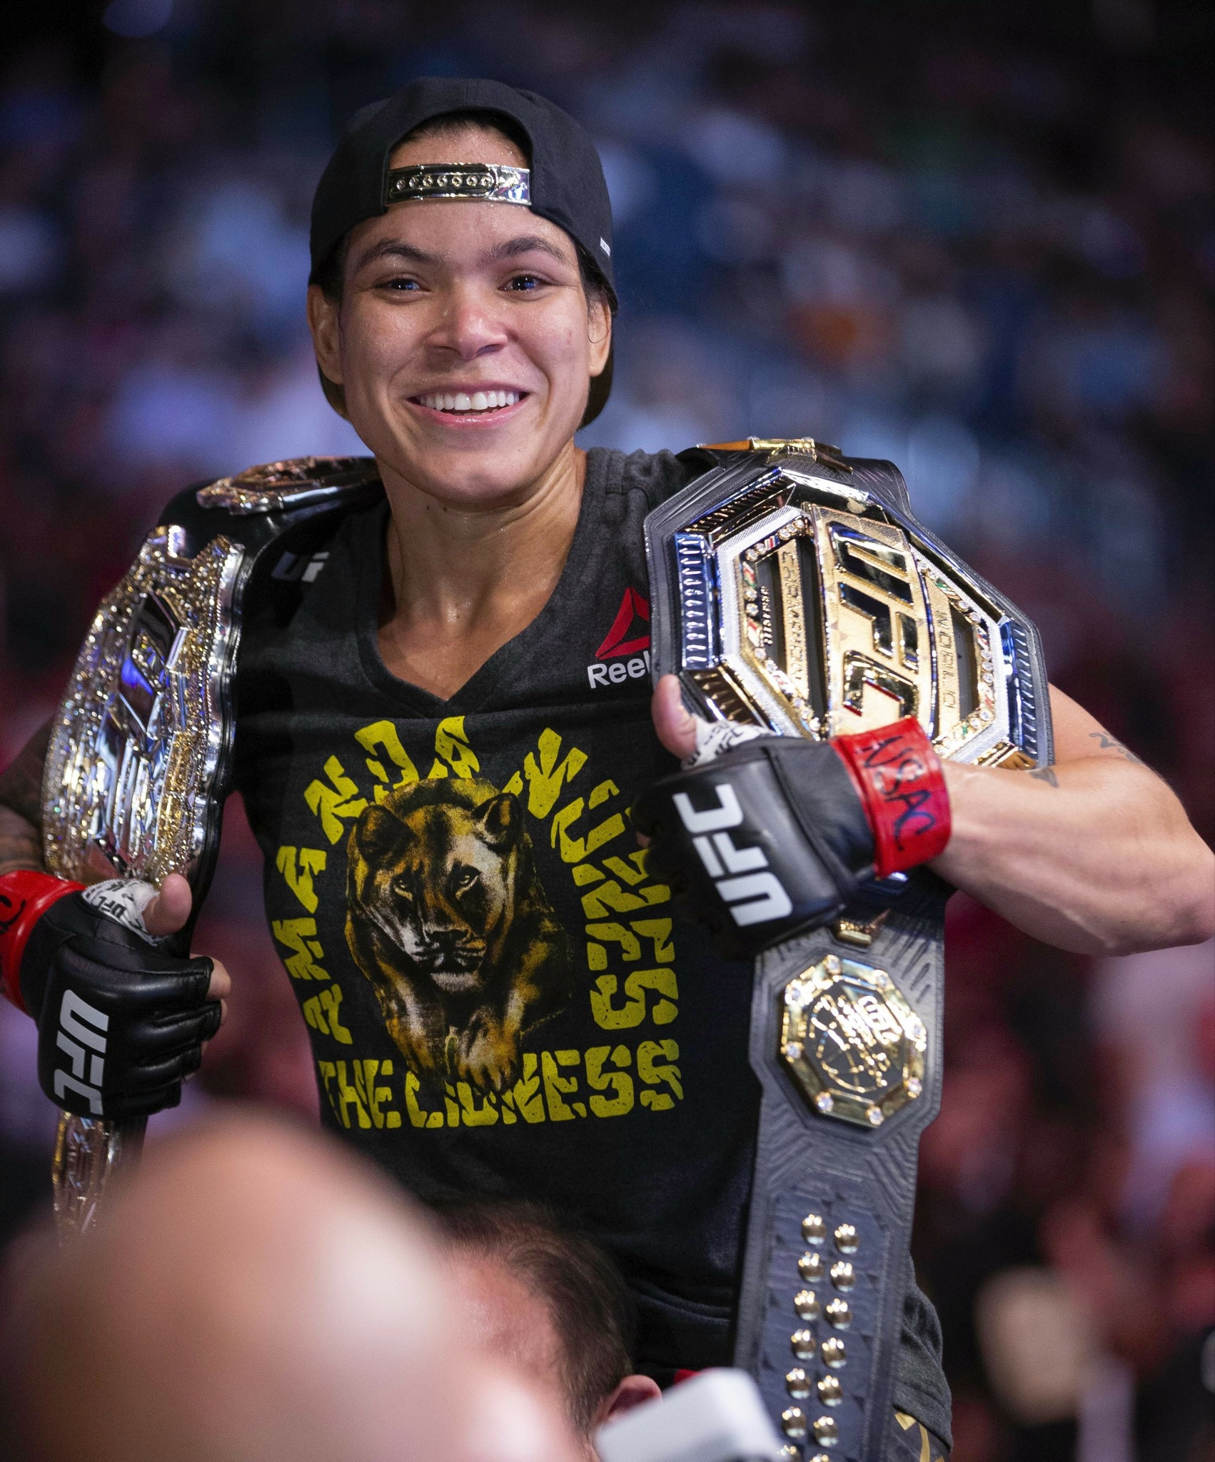



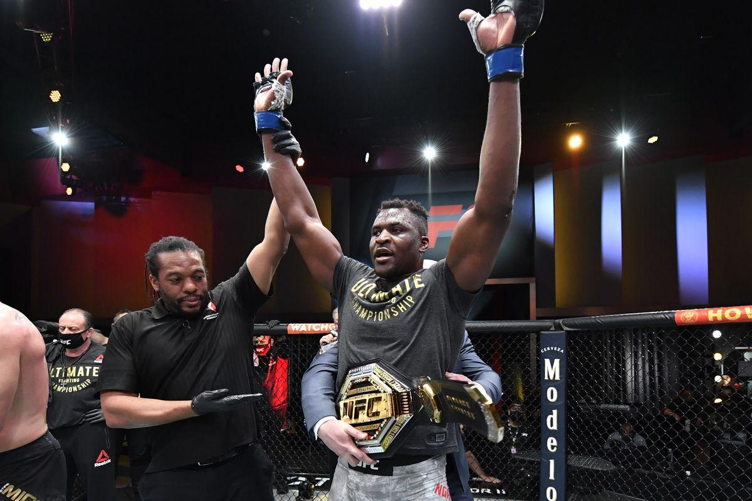
Notes:
So, if we were to witness some of the best UFC fighters against each other, like..
Conor McGregor vs Francis Ngannou (ninganu)
... or…
Amanda Nunes vs Valentina Shevchenko
Who would you root for? Place your bets!

Slide 4
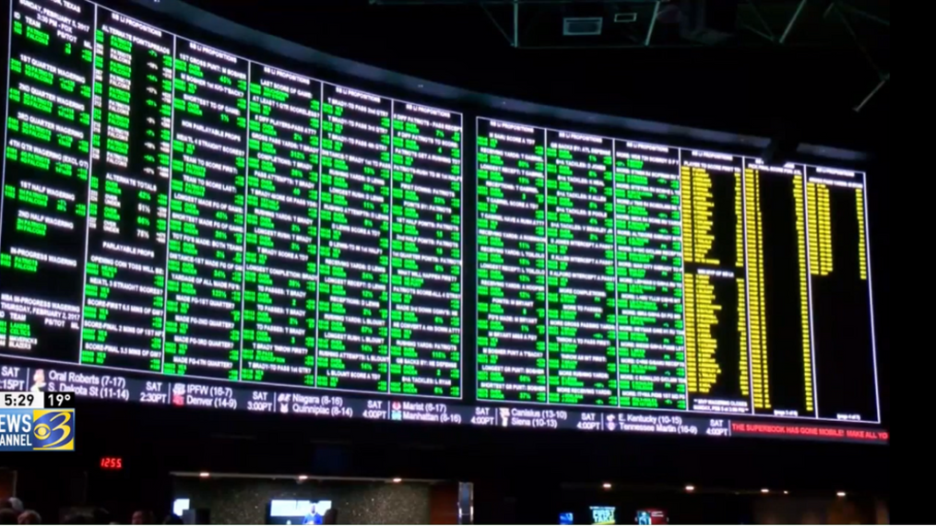
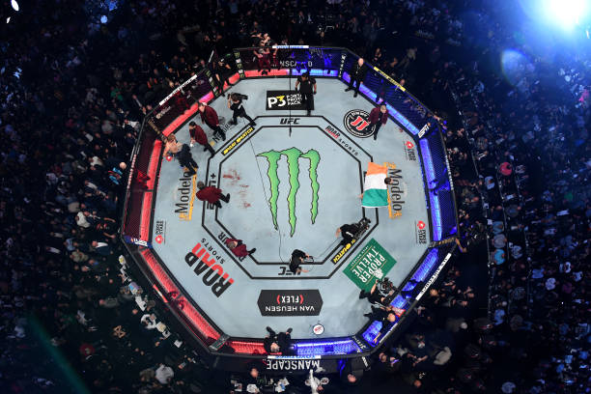
$155 billion
Notes:
Sport betting is a $155 billion industry and fight matches rank among the top in the industry!
Gambling and “The Fight Game” have always gone hand in hand. There are many analysts that make a living off of predicting fight outcomes based on the eye test or on data that has no proven correlation to actual wins. On the other hand, a casual fan is typically basing their predictions on the most basic statistics that are provided by the broadcast.
What would you need to know before placing your bet..?

Slide 5
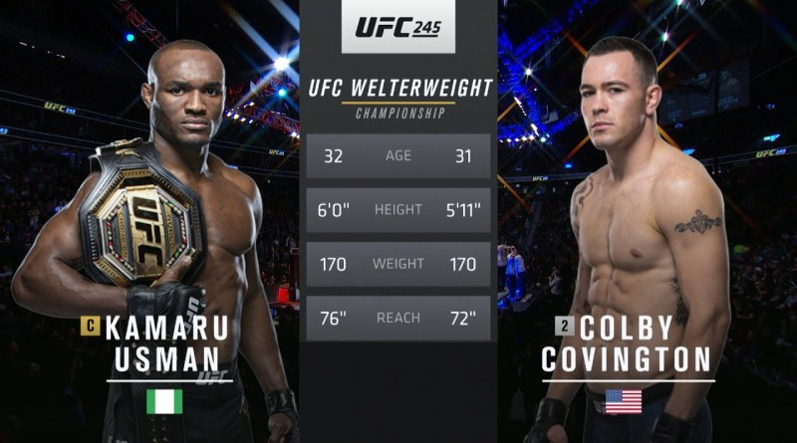

Notes:
Mixed Martial Arts (MMA) fighter statistics involve everything from skill centric values such as wins and significant strikes to physiological measurements such as height and reach. There are over 100 features that can be analyzed before any given fight..
So where's the edge?
Our goal is to see if there is a way to apply modern machine learning techniques to historical fight data to best understand which statistics, or features, are most relevant in order to find trends and predict the outcomes (win/draw/loss) of each fight.

Slide 6

UFC Match Outcome Predictor
A quest to predict the unknown
Notes:
Cesar Greeting - 0:15 seconds (“Welcome to our “UFC Match Outcome Predictor” presentation. In the Data Science World we all know Dimas is the reigning champ but what about hypothetically in the Octagon? As Bruce Buffer said its time to find out”)
Priti/Cesar Intro - (breaks down MMA lingo, introduces audience to the world of MMA & stuns with viz) - 3:30 minutes
Cesar hands-off to Mattie - 0:15 seconds
Mattie DB - 3:30 minutes
Cesar hands-off to Andrew - 0:15 seconds
Andrew - ML - 3:30 minutes
Cesar hands-off to self - 0:15 seconds
Cesar/Priti - Results including Interactive Visualization - 2:00 minutes
Closing Slides - Fun Facts, Credits and Sources - 1:30 minutes

Slide 7

Quest for W’s
The What, When & Where of Winning
Just like fighters strive to win, we strive to harness the power of data science to help us win by answering complex questions.
Our quest is to explore if there is a way to wrangle and distill data such that we are able to determine the future outcome of UFC fights based on previously fought bout data metrics.

Slide 8
What?
Why?
Where?
01
02
03
Topic:
Our Process:
Source:
Use data and fighter statistics to create an educated prediction on who will win the fight.
As fans, it would be interesting to best predict who will win a fight.
We acquired a dataset from UFC saved in Kaggle.com

Slide 9
What We Plan On Answering
1. What are the top 5 fighter metrics that contribute to winning a UFC match?
2. Which of the fighter metrics carry more weight than the others?
3. How much do biometric physical factors, i.e. age, height, weight, affect the outcome of the match?
4. Does having a higher rank predict the outcome?
5. Do the number of win streaks necessarily predict a higher chance of winning?

Slide 10


Tools and Techniques
Data & Preprocessing
Analysis & Viz
PostgresSQL Database
Python
Pandas
SciKit-Learn
Google Slides
Tableau Public
Label Brushing
Filters
Heat Map
Notes:
Interactive Elements --
Chart with label brushing to allow for automatic appearance of an identifying label when cursor hovers over a particular element
Table with filters to see side by side comparison of fighter features
Heat map to show intensity to showcase intensity of fighter statistics against one another

Slide 11
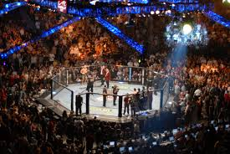

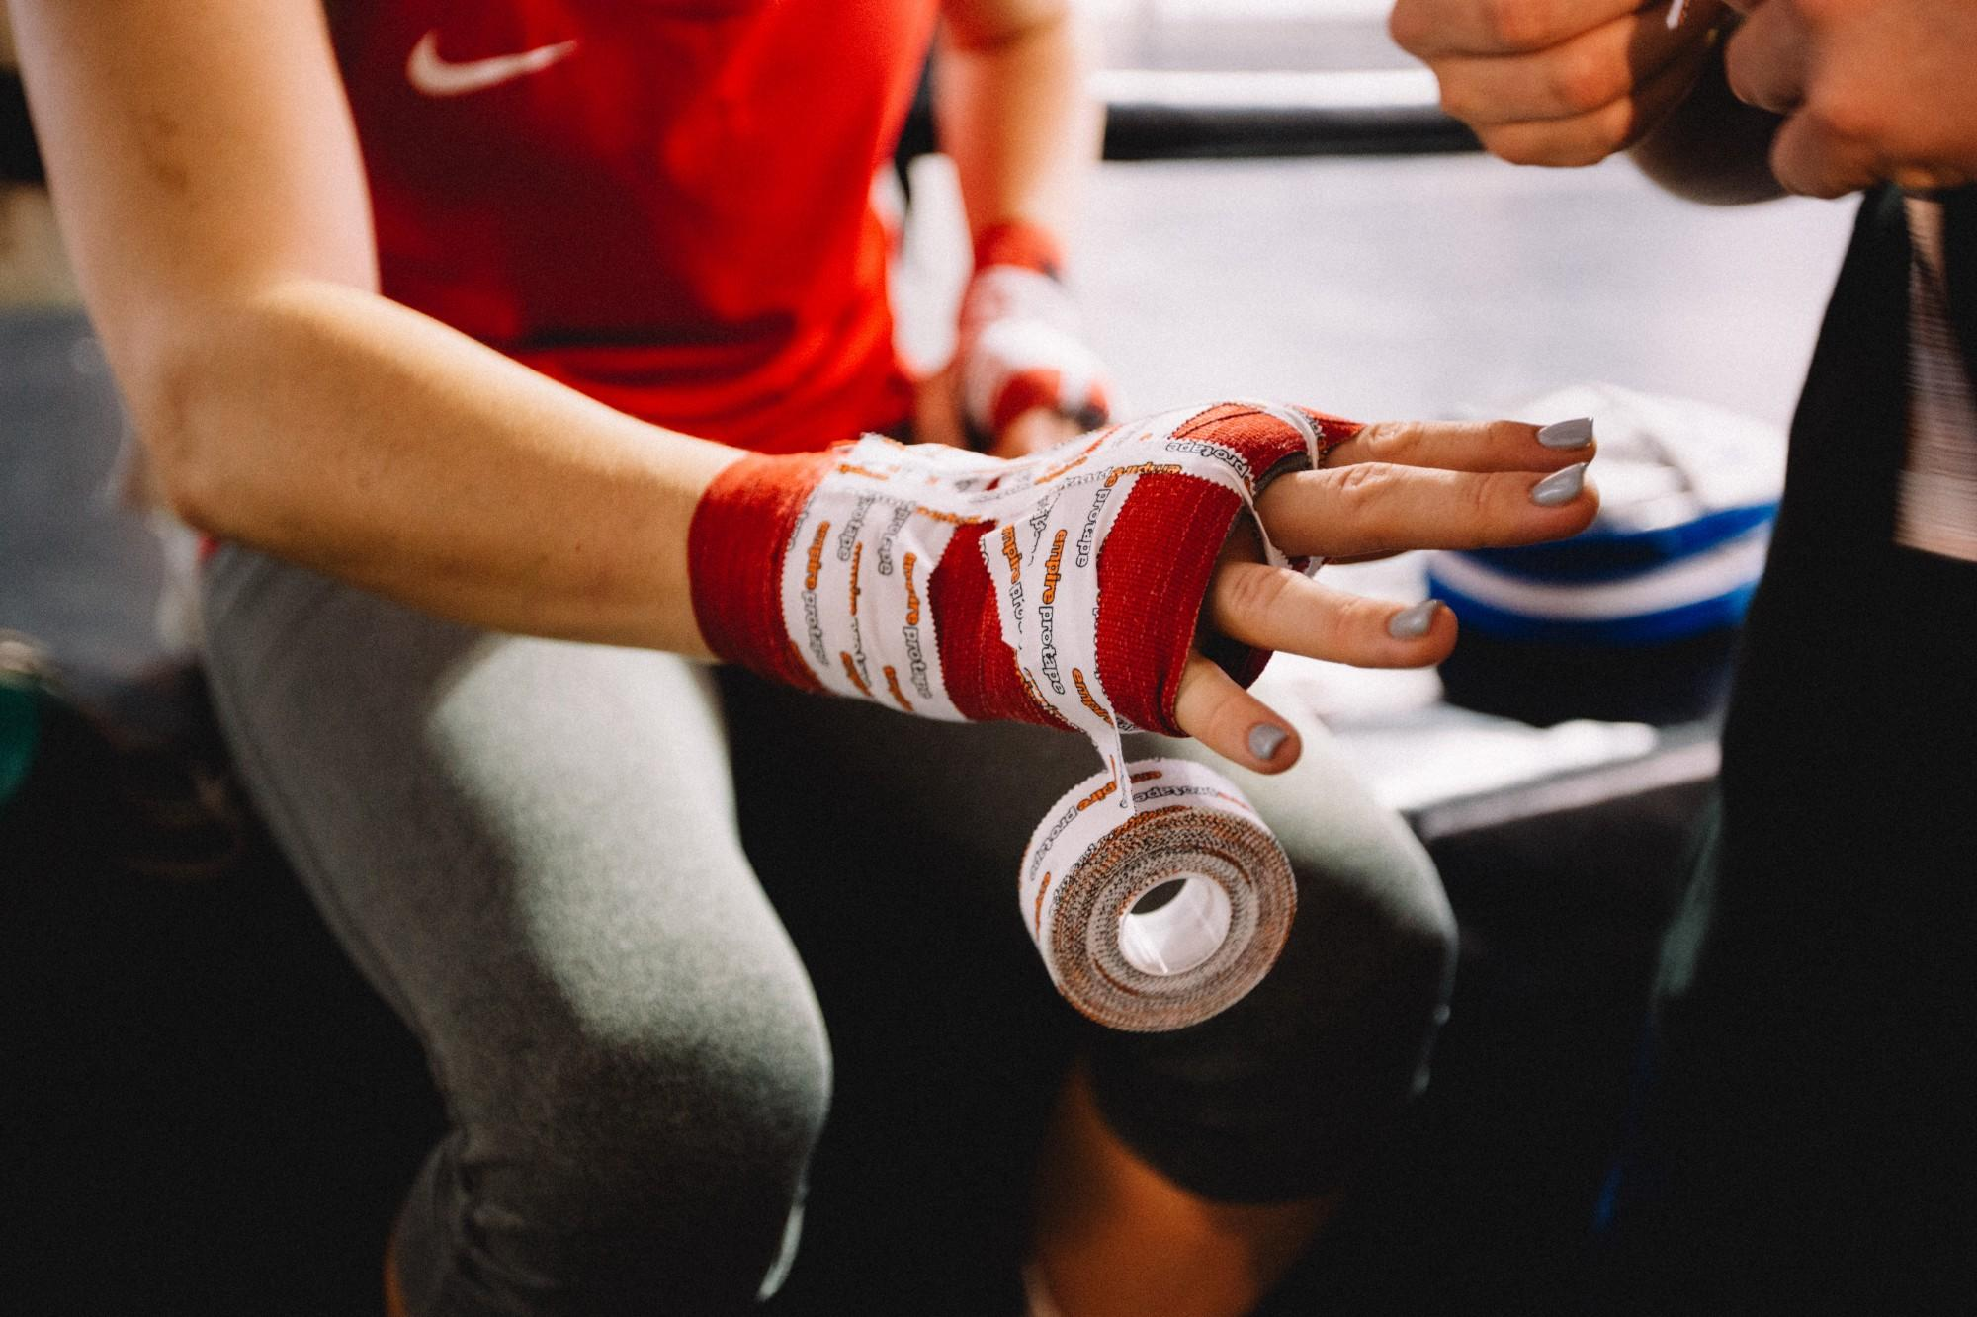
Dataset and Features
4,566
1,286
137
UFC Fights
Fighters
Variables
dating from March 2010
to Feb 2021
and their previous
bout metrics
correlating to Red and Blue fighters
Notes:
The Ultimate Fighting Championship (UFC) is a mixed martial arts (MMA) promotion that has held over 500 events since its beginning in 1993. The purpose of the early UFC competitions was to identify the most effective martial art in a contest with minimal rules and no weight classes between competitors of different fighting disciplines like boxing, kickboxing, brazilian jiu jitsu, wrestling, taekwondo, and judo. The UFC started as an idea to promote a family's martial arts school.

Slide 12
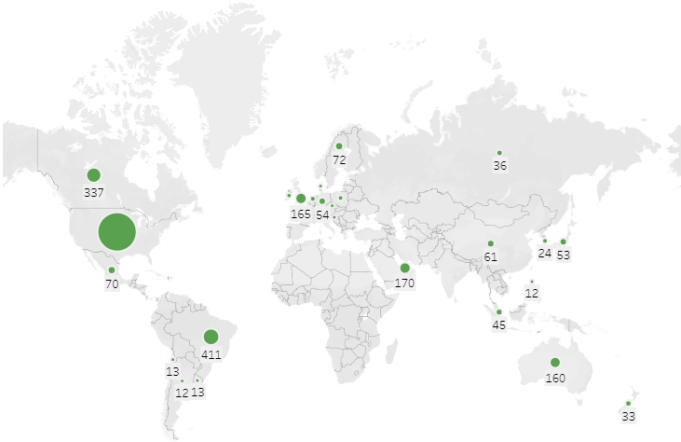
A Global Force Not To Be Reckoned With
Notes:
In the early days, UFC fights were held only in states that didn't have athletic commissions to avoid regulation. The UFC has now expanded to 25 countries; the number of bouts held outside the US has increased from 61 in 2010 to 236 in 2019.
More than 59% of fights were held in the US while Brazil held the most fights outside the US.

Slide 13
Data Exploration phase
Blue
Red
Differences in the average accuracy of takedowns taking place between fighters were calculated by using the following function: “Blue corner score minus (-) Red corner score” where a negative score actually favors the Red corner fighter.
Exploring historical data of past matchups in the UFC for past multiple years, it was found that the great majority of the time, the fighter in the red corner has a slightly greater chance as the victor in a match-up
Notes:
Exploring the data we found that not all data is usable in its original state. we would need to devise a way to create us by determining the differences in contributing factors and creating

Slide 14
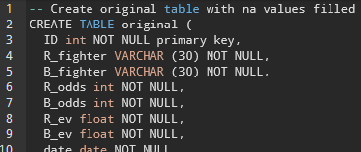
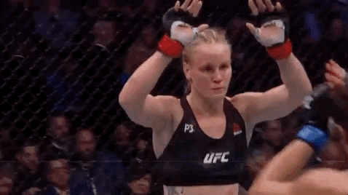
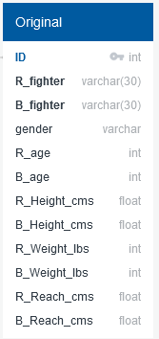
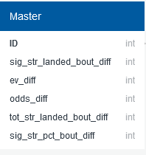
Database
Data collection and processing
Table creation and queries
Export joined data CSV
20XX
Database Creation and data import
Join of data
Notes:
The Database engine is created in python using sqlalchemy. The data pulled from the kaggle website was previously processed and molded into a clean dataset from which to read into this database creator. This data is retrieved and executed into relational database manager pgAdmin to use the management tool PostgresSQL.
(*CLICK*)
Here** our processed data read into two separate tables; one called Original data and the other called Master data. Both of which were created in python and imported into pgAdmin.
Each of these focus on the two main categories we find influence match outcomes. The great question if biometric factors; seen in Original data, or skills of fighter metrics; in Master data hold the greatest influences. Some details of the above, R_fighter and B_fighter are categorized as varchars with 30 to hold names of the most common sizes. Age and weight values as well as the significant strikes, odds of the underdog or favorite fighter, total strikes landed and significant strike percent values are labeled as integers because they are whole value numbers. Floating variables used above have more precise numerical values that include a decimal place in their data. These include height and reach of each fighter measured in centimeters.
These two categories are Joined together with pgAdmin Query tools and exported as a UFC fighter_comparison csv file.
(*CLICK*)
(1:45)

Slide 15
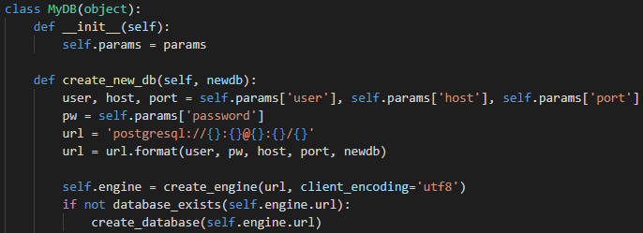
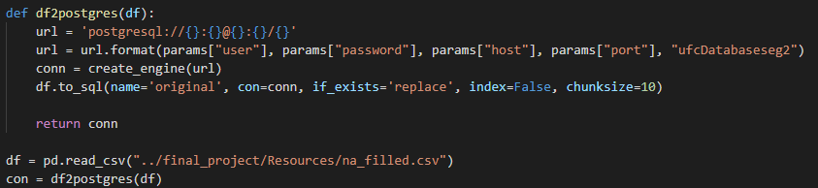

Database: how to connect dataframes in python
20XX
20XX
Import tools
Create database engine
Connect dataframe to sql
Read in csv
Sqlalchemy
Sqlalchemy_utils
Pandas
psycopg2
def create_new_db
conn=create_engine(url)
df.to_sql
df=pd.read_csv(“...csv”)
con=df2postgres(df)
Notes:
There are a couple tools used to create and connect a database in python. Sqlalchemy is used to create the engine and database. Pandas is used as pd to read in the csvs.
To create this database the params are set to connect the postgresql user, password, host, port, and new database. Then the engine creates that database.
Here a connection is created between that new database and the setup of where data will be imported.
Through pandas our csv data is imported in and read into this new postgres dataframe.
This action is performed with two separate python files, one coded for the Original data table creation using pandas reading the cleaned and na filled csv, and the second python file specialized for the Master data table reading in the preprocessed data csv. I wanted to note that the same database connection is used in both these instances so there are two separate tables, Original and Master each reading in their own csvs, living under the same database header in pgAdmin as two tables. Here the view was created to see the join made between Original and Master.
(*CLICK*)

Slide 16



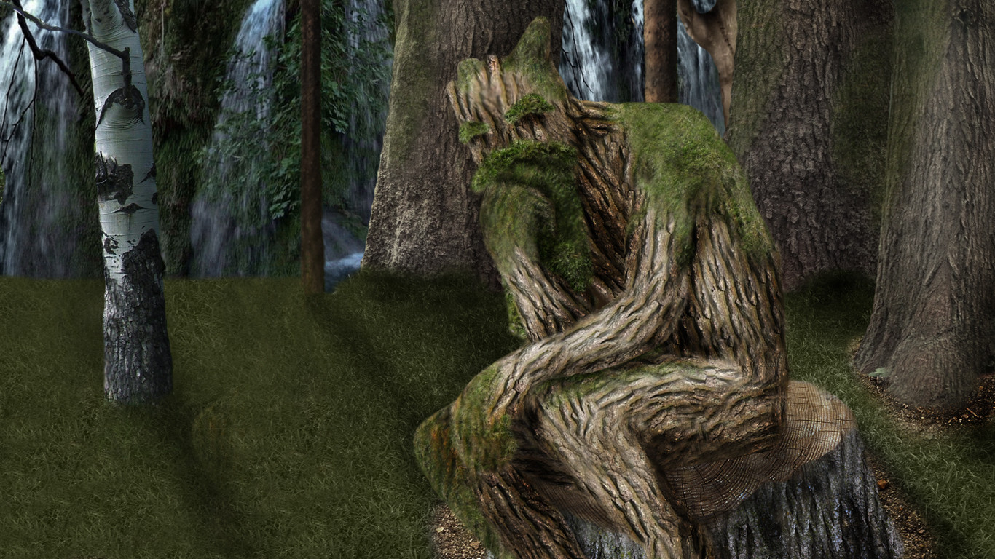
Analysis Phase
We compared the following 4 models to see which model best fit our data, research requirements and structure.
K-Nearest Neighbors
Random Forest Model
Decision Trees
Logistic Regression Models
Supervised learning algorithm
Simple, supervised machine learning algorithm
Builds regression or classification models in the form of a tree structure
Basic statistical model that uses a logistic function to model a binary dependent variable
Notes:
K-Nearest Neighbors: K-Nearest Neighbour is one of the simplest Machine Learning algorithms based on Supervised Learning technique. K-NN algorithm assumes the similarity between the new case/data and available cases and put the new case into the category that is most similar to the available categories.
Random Forest Model: Random forest is a supervised learning algorithm. The "forest" it builds, is an ensemble of decision trees, usually trained with the “bagging” method. The general idea of the bagging method is that a combination of learning models increases the overall result.
Logistic Regression Models: Logistic regression models the probabilities for classification problems with two possible outcomes. It's an extension of the linear regression model for classification problems.
Decision Trees: A class of very powerful Machine Learning model cable of achieving high accuracy in many tasks while being highly interpretable. What makes decision trees special in the realm of ML models is really their clarity of information representation.

Slide 17
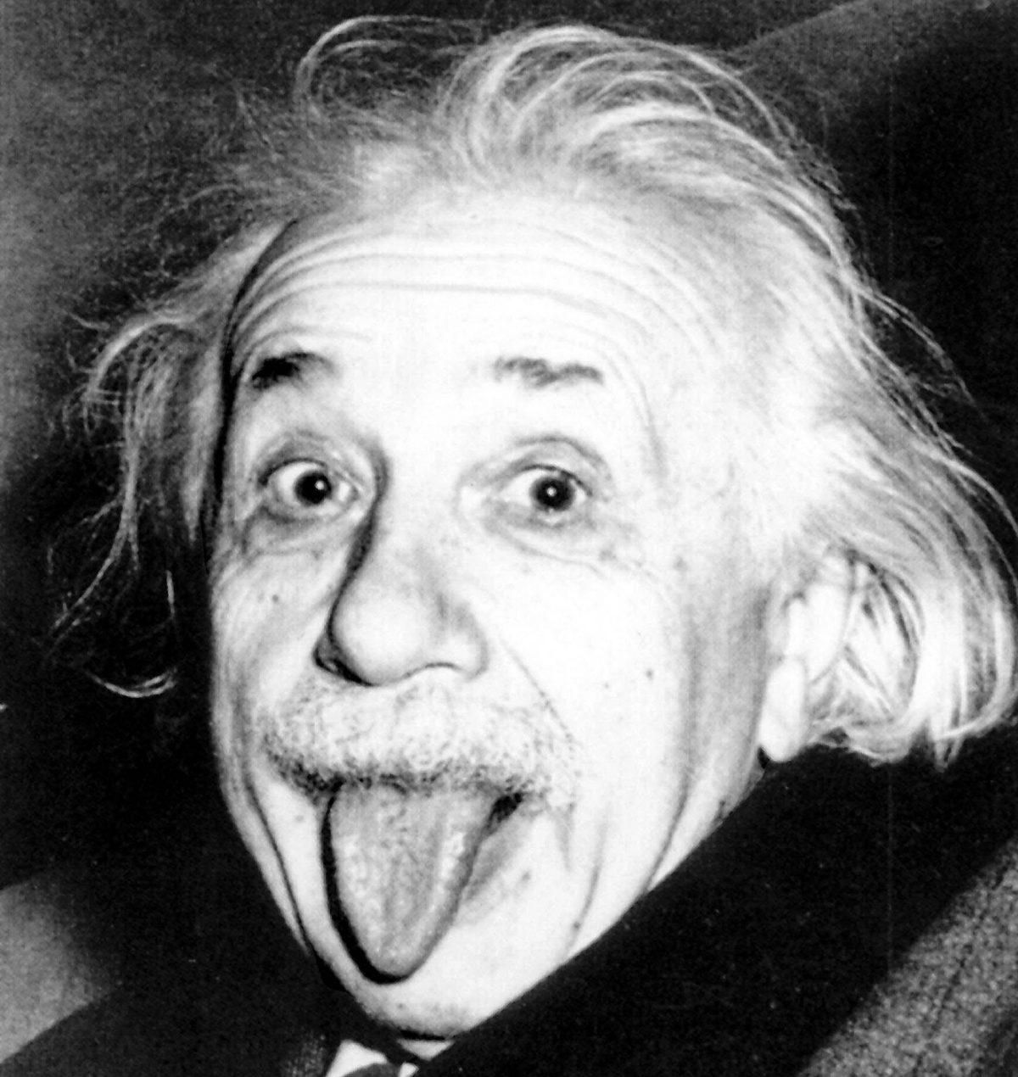
Albert Einstein
“Everything should be made as simple as possible, but not simpler.”
Notes:
Fundamentally, a baseline is a model that is both simple to set up and has a reasonable chance of providing decent results.

Slide 18
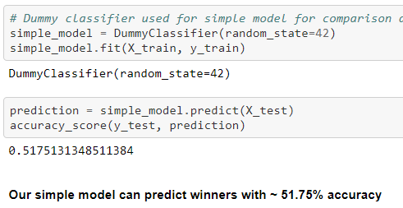
Can’t have a good model without a good base
Logistic Regression Model
For our base model we chose the Logistic Regression model
Our simple model can predict winners with the below accuracy percentage:
Notes:
“Just like you can’t be a good fighter without a solid base or foundation from which to work from, you can’t have a good machine learning model without first creating a baseline model.
When trying to classify structured data or natural language, logistic regressions will usually give you quick, solid results.
Our simple model without removing null values can predict winners with ~ 51.75% accuracy
Since nobody is truly satisfied with a 50/50 odds we had some tweaking to do to improve accuracy of baseline LR model even before comparing new models.

Slide 19
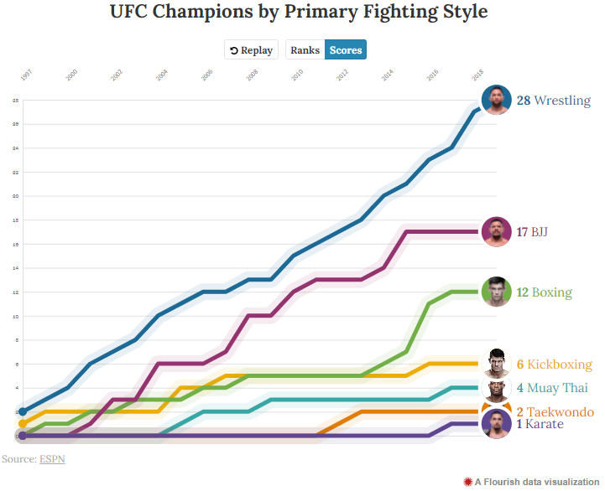
Fun Fact
Most UFC champions have one base in common:
Strong Wrestling Background
Notes:
Since UFC started in 1993 there have been 190 crowned champions these past 28 years
28 UFC champions, roughly 15% of all champs, have come from the sport of wrestling, making it the most prevalent base for UFC gold
Moral of the story: “No matter how hard a kick boxer trains his wrestling when he's in his twenties and ready to start MMA, he will likely never be able to stop the takedowns of a guy who's been wrestling since he was a kid.”

Slide 20
The Chosen Two
-Both models perform best with large datasets
Neural Network Models
Random Forest Model
Great for images, audio or text.
Prerequisites include filling missing values, converting categorical data into numerical and scale features into the same range or at the very least similar.
Seamless feature engineering transition to improve accuracy
Great for tabular data
Automates missing values present in the data.
Requires less preprocessing and the training process is simpler.
Reduces overfitting by aggregating several decision trees which helps improve accuracy and reduces error due to bias.

Slide 21
Machine Learning Analysis
Basic Classification Model
Data Preprocessing
Random Forest / Neural Network comparison
Preliminary data preprocessing
Can we establish a correlation between the variables and wins with this data?
What are the top 25 most important variables?
How can we improve performance of our model?
Feature Engineer
Eliminate 'noisy' data
Find null values and fill them
Encode categorical variables
Which model will predict fight outcomes with the greatest accuracy?
What input features and adjustments lead to optimal performance?
Is our model overfit to our provided dataset?

Slide 22
Simple Model
Correlation between variables and wins?
15 variables with correlation of 25% or higher
DummyClassifier
51.75% accuracy

Slide 23
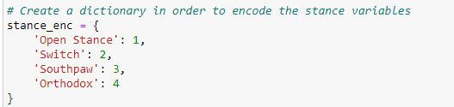
Data Preprocessing
Feature Engineering
(Blue Corner stats) - (Red Corner stats)
Noisy Data
Date, location, weight class, ect.
Columns with predominantly null values
Null values
True nulls? Or zeros?
Categorical values to be encoded

Slide 24
Random Forest Vs. Neural Network
Random Forest
75/25 train/test split
78% accuracy
insert confusion matrix
Model.feature_importances_ ---> Results
Neural Network
Hidden layer 1 - 25 neurons
Hidden layer 2- 12 neurons
25 epochs
ReLu activation
Output layer- sigmoid activation
Accuracy: 77.93%

Slide 25
Is the chosen model overfit?

Slide 26
Machine Learning Analysis
How data was split into training
Improved overall accuracy over the baseline via feature engineering
Ran correlation function
Consolidated duplicate data by creating ‘difference’ variable
Dropped similar characteristics (i.e. date, location & weight class etc)
Dropped all ranking columns except one pertinent to eliminate null values
NaN columns filled with true zero value
Testing sets and model choice—limitations and benefits
Compared NN vs RF
Both resulted in over 75% accuracy (NN-76% vs RF 78%).
Best results attained with standard 25% test split.
Both models did not overfit which is ideal.
Notes:
How data was split into training
We then set out to create a model that would perform better than our baseline model, by first preprocessing the data and implementing feature engineering- data_preprocessing.ipynb. In this dataset we were dealing with 137 variables many of which contained a significant amount of null values. In order to ensure key variables were not eliminated, we first encoded the winning column and ran a correlation function in pandas to see which variables most correlated to winners. After that, we recognized that the majority of our variables were duplicates in a sense—statistics for the Red Corner fighter, and statistics for the Blue Corner fighter. To increase correlation and concentrate the data, we subtracted all Red Corner statistics from Blue Corner statistics (Blue-Red) and created 'difference' variables. Then we dropped all variables that were common to both fighters in that fight; such as date, location, weight class, ect. Looking at the data further we recognized there was a large chunk of variables associated to rankings in a given weight class that contained a significant amount of null values. After further analysis only one of these rankings columns was pertinent and all the others were dropped. Then columns with strings were encoded, and false NaN columns were filled with their true value of 0.
Testing sets and model choice—limitations and benefits
For our improved model we decided to compare the results between a Random Forest classifier and a Deep Neural Networkufc_RF_vs_NN.ipynb, because we were looking to classify winners with a very large dataset. We tinkered with different train/test splits but results were best with a standard 25% test split. The RF Classifier resulted in 78% accuracy while the Deep NN resulted in 76% accuracy. It does not seem that either model was overfit, and they were able to predict winners of the fights with over 75% accuracy.

Slide 27
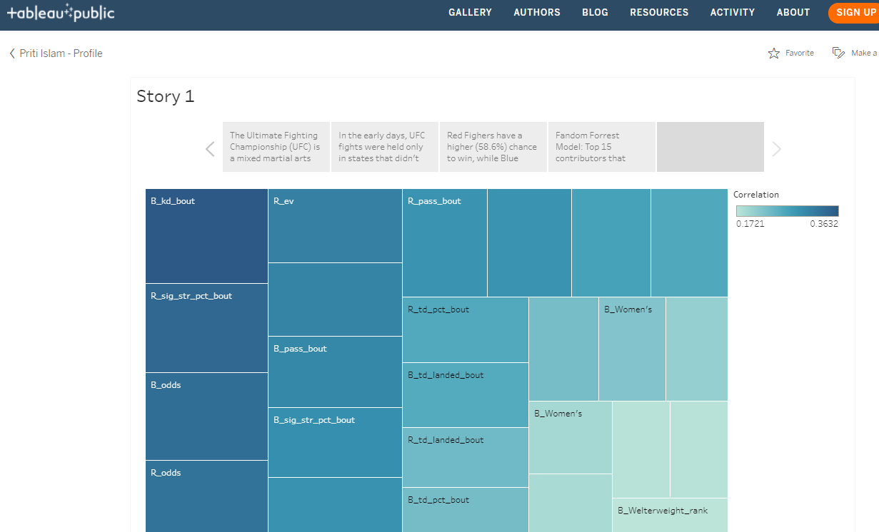
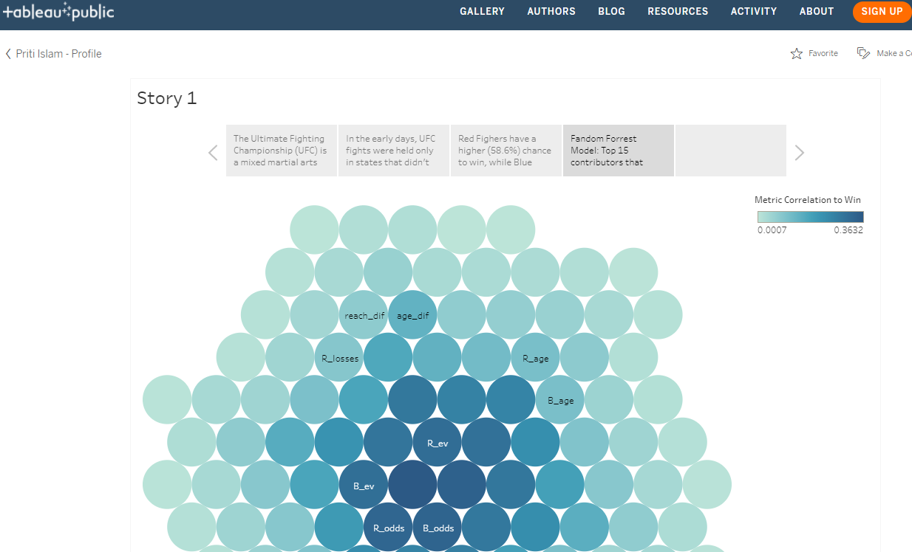
Dashboard Preview
URL Link

Slide 28
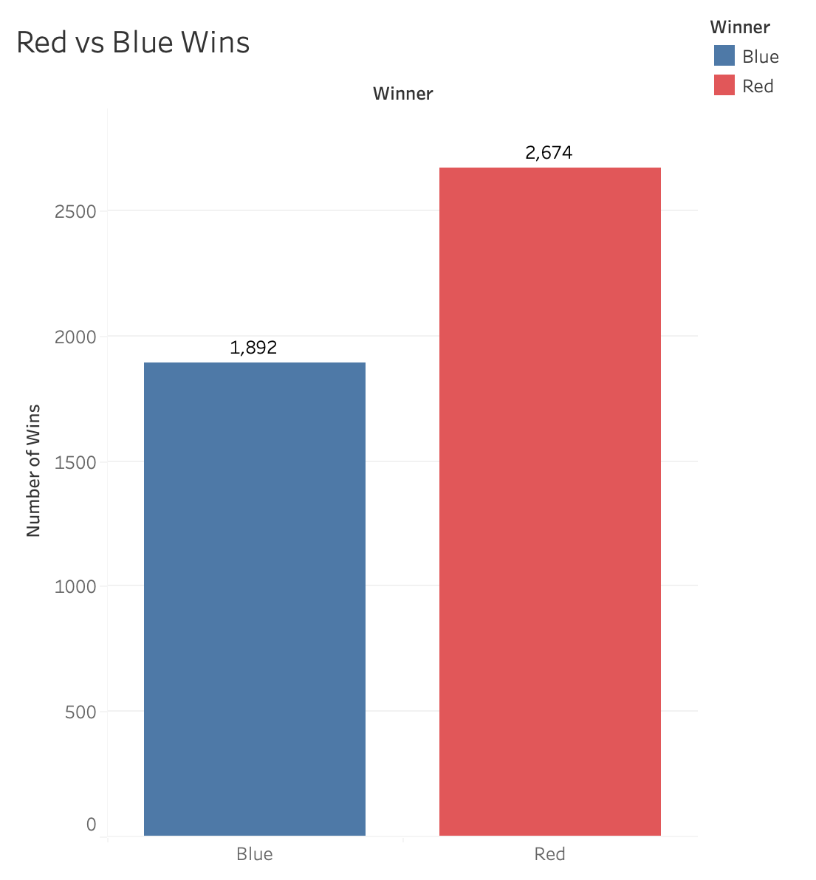
Results
Fighting on the red corner offers a 17% higher chance of winning alone.
Notes:
Red Fighters have a higher (58.6%) chance to win, while Blue Fighters have a lower (41.4%) chance to win. Thus, fighting on the red corner offers a 17% higher chance of winning alone.

Slide 29
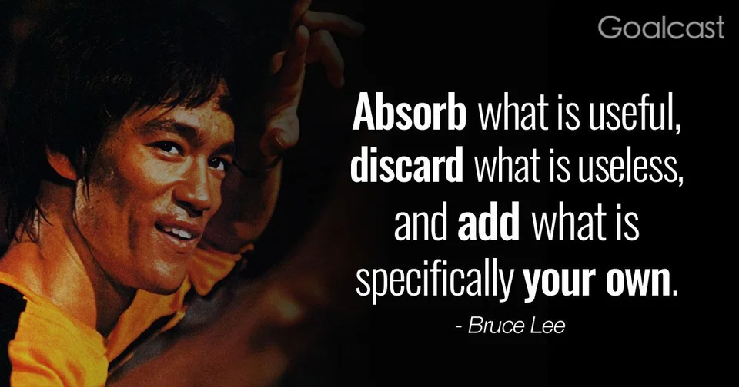
Results I
1. What are the top 5 fighter metrics that contribute to winning a UFC match?
Average number of knockdowns per fight
Significant strikes per fight: Strikes at a distance and power strikes in the clinch and on the ground.
Betting Odds: Human probability statistic made by a leading betting company or odds compiler
Payout: The fighter that has the established higher financial incentive or payout for winning
Average number of guard passes in a fight: On the ground which the fighter that has a statistically better chance at entering a more dominant position (normally accomplished using wrestling or brazilian jiu jitsu techniques)

Slide 30
Results II
2. Which of the fighter metrics carry more weight than the others?
Average number of knockdowns per fight: This fighter is known for statistically knocking down his opponent the most using significant strikes.
3. How much do biometric physical factors, i.e. age, height, weight, affect the outcome of the match?
Since significant strikes are the 2nd most important contributing factor a fighter's reach benefits his ability to deal these significant strikes from a distance
4. Does having a higher rank predict the outcome?
Having a higher rank does increase the betting odd which is the 3rd significant factor to predict the outcome.
5. Do the number of win streaks necessarily predict a higher chance of winning?
Win streaks are a top 15 contributing factor but fall short of top 5.

Slide 31
WHO WILL WIN?
Notes:
"As the phrase goes the proof is in the pudding. We just can't tell which individual will win without historical data of previous performance. Whoever owns the best mix of the top 5 weighted metrics previously mentioned is our favorite to win according to numbers."

Slide 32
Source
Poll: Best Base?
Folkstyle Wrestling Produces UFC Champions.
ESPN MMA Base Viz

